Slide 1



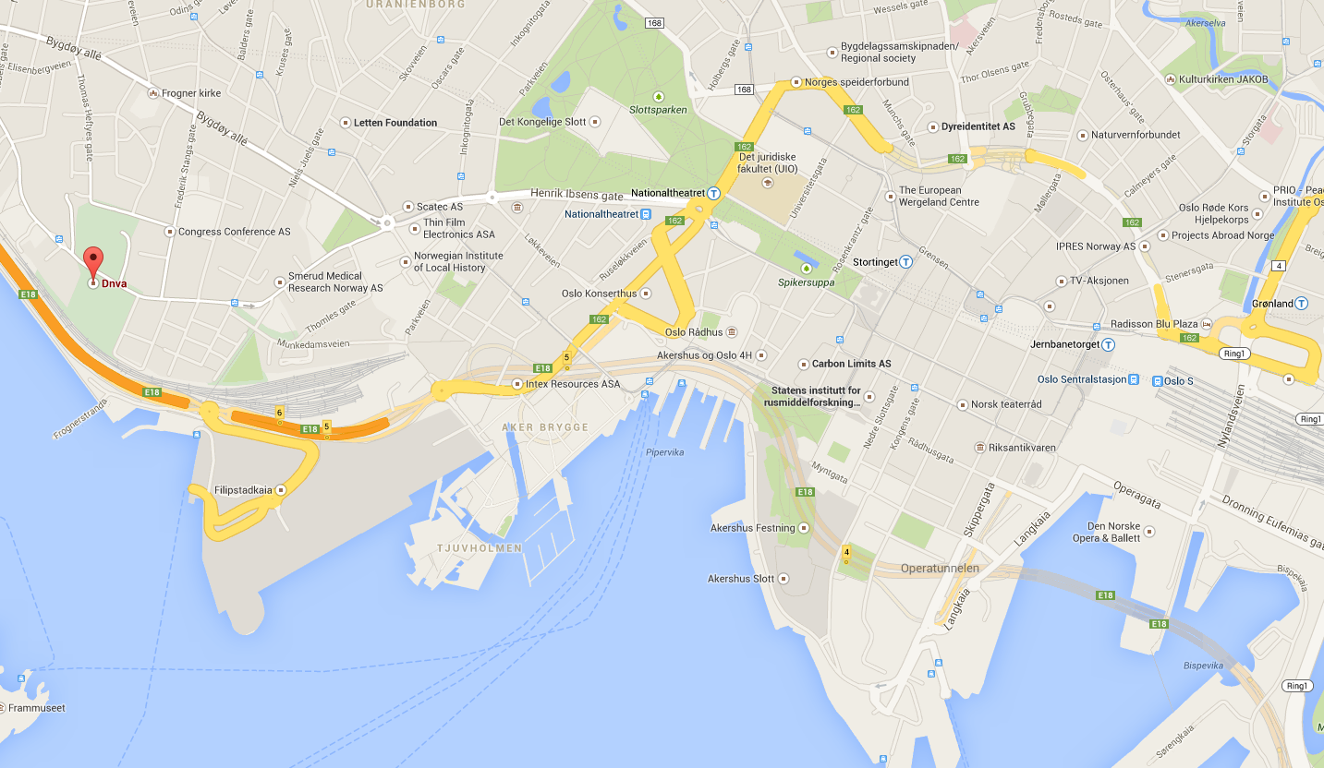
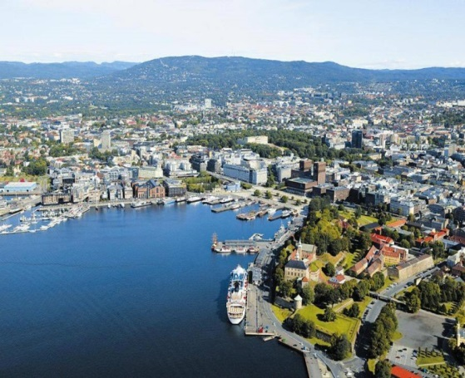
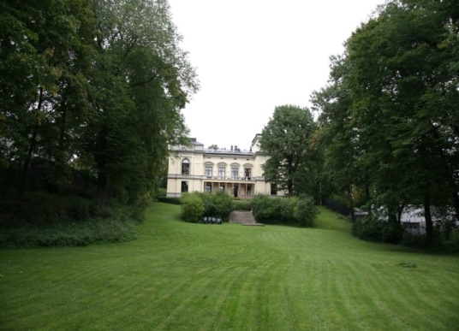
International Workshop on Soft & Complex Matter
Norwegian Academy of Science and Letters
Drammensvegen 78, Oslo, Norway, October 15-16, 2015
The scope of the workshop:
Physics and chemistry of soft&complex matter and related phenomena.
From basic science and natural phenomena to applications and technology.
Speakers:
Daniel Bonn (Univ. Amsterdam, Netherlands)
Paul Dommersnes (NTNU, Norway)
Maria Helena Godinho (New Univ. Lisboa, Portugal)
Carl Fredrik Gyllenhamar (Independent Consultant, Norway)
Geir Helgesen (Institute for Energy Tech. (IFE), Norway)
Mile Ivanda (Ruder Boskovic Institute, Zagreb, Croatia)
Kenneth D. Knudsen (Institute for Energy Tech. (IFE), Norway)
Reidar Lund (Univ. Oslo, Norway)
Kristian P. Olesen (Desert Control, Norway)
Adrian Rennie (Uppsala Univ. Sweden)
Silvia Vignolini (Univ. Cambridge, UK)
Practical information to participants:
The workshop starts at 1700 Oct. 15 and
ends at 1600 Oct. 16 2015
Organizer and contact:
Jon Otto Fossum (jon.fossum@ntnu.no)
NTNU, Trondheim, Norway
http://english.dnva.no/
Notes:
1

